Slide 1
Introduction to Machine Learning
Institute of Acoustics and Speech Communication
Chair of Speech Technology and Cognitive Systems
Workshop
AI Applications for Medicine – International Summer School in Dresden
Dresden // 13.09.2023

Slide 2
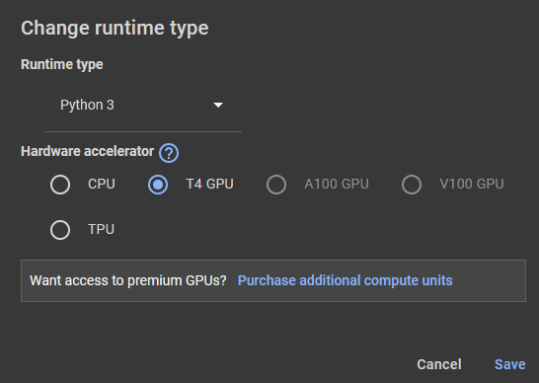

Prerequisites
Ensure that you have a valid Google account.
Log in to Google Colab: https://colab.research.google.com/
Load the Github repository: https://github.com/TUD-STKS/SECAI-Summer-School
Click on the Colab badge to open the Jupyter Notebook
Choose the T4 GPU as hardware accelerator in the Runtime settings.
Run the first code cell of the notebook

Slide 3
A very brief introduction to Python
This workshop requires some basic knowledge about Python
It is particularly useful to know
Mathematical operations
How to load packages and instantiate objects
Important Python packages:
Numpy for efficient matrix handling and linear algebra
Pandas for efficient tabular dataset handling
Scikit-learn for developing simple machine learning models
PyTorch/Tensorflow for more complex machine learning and deep learning models
Seaborn for statistical data visualization

Slide 4


What can you expect from this workshop?
if $K\left(ML\right)==0$
else if $K\left(ML\right)≤ ε$
else if $K\left(ML\right)≫ ε$
else
Then get in touch with an exciting research area
Then learn a few new aspects or get new ideas
Please continue this workshop for me

Slide 5
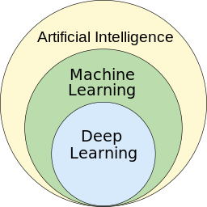
What is Machine Learning and why is it so important?
Machine Learning (ML) is part of the research area of Artificial Intelligence
Goals:
Algorithms learn to solve problems data-drivenly
Find hidden information in data
Methods:
Regression
Classification
Clustering
Deep Learning (DL) is a subfield of ML
Larger models
Need and use more available data
https://upload.wikimedia.org/wikipedia/commons/1/1b/AI_hierarchy.svg

Slide 6
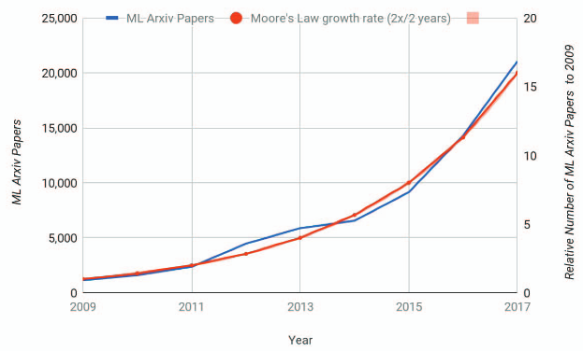
What is Machine Learning and why is it so important?
The amount of available data is increasing daily
New models and fast hardware is available
The number of ML articles uploaded to arXiv in one year exceeds Moore‘s prediction for chip production
More than 50 ML articles appear daily
Powerful hardware is available
Growing number of applications:
Speech, image, audio recognition
Similarity analysis of music signals
Time-series prediction
J. Dean, D. Patterson and C. Young, "A New Golden Age in Computer Architecture: Empowering the Machine-Learning Revolution," in IEEE Micro, vol. 38, no. 2, pp. 21-29, Mar./Apr. 2018, doi: 10.1109/MM.2018.112130030.

Slide 7
Outline of this workshop
How to getting started with a new ML task?
Descriptive analysis
Task definition
Baseline models
Linear regression in one line
Linear regression in multiple lines
Advanced models
Multilayer Perceptron
Convolutional Neural Networks

Slide 8
Getting started
With a new ML task

Slide 9
How to getting started with a new ML task?
Getting started with a new ML task involves several complex steps that we partially consider within this workshop:
Dataset analysis:
How can we load a dataset?
Which data is contained in the dataset?
Task definition: Which kind of task do/can we solve?
Model selection:
How much computational ressources do we have?
How much training data do we have?
Model training and evaluation
Model optimization
Model prediction

Slide 10
How to getting started with a new ML task? Dataset analysis
A dataset can have different kinds of data that requires specific preprocessing:
Potential text data needs to be converted to a numerical representation
Numeric data might have different data types (integers, floats)
Deal with missing data
We need to analyze the data:
How are the features distributed?
What is the value range of the different features?
Different models require the dataset to be prepared in different ways:
We need to flatten the data for feedforward networks
We might need to crop/pad sequential data to equal lengths

Slide 11
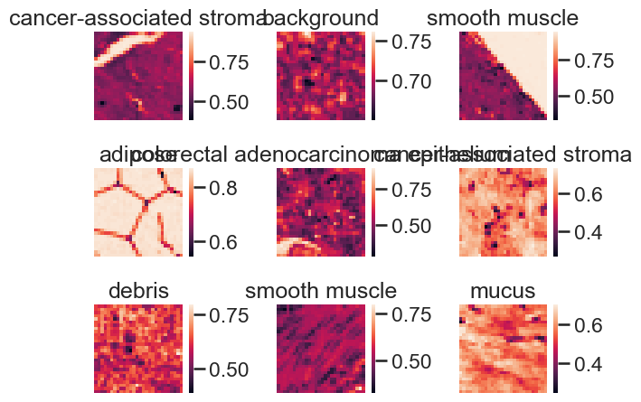
Dataset analysis The PathMNIST dataset (Part of MedMNIST v2)
107,180 images divided in nine different classes
The images are RGB images with 28x28 pixels
The classes are roughly uniformly distributed
Each class is a different kind of tissue, such as adipose, background, muscle or cancer cell
Yang, J., Shi, R., Wei, D. et al. MedMNIST v2 - A large-scale lightweight benchmark for 2D and 3D biomedical image classification. Sci Data 10, 41 (2023). https://doi.org/10.1038/s41597-022-01721-8

Slide 12
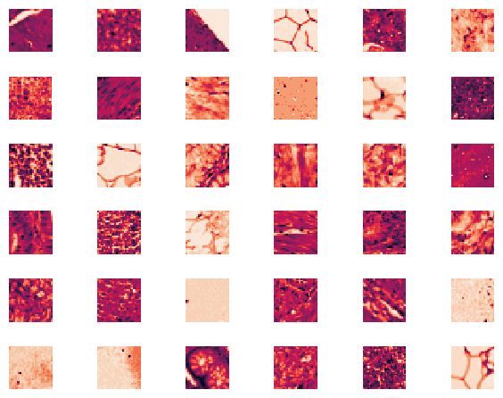
Dataset analysis The PathMNIST dataset (Part of MedMNIST v2)
We already partially prepared the PathMNIST
The RGB images are converted to grayscale
All images are stored in a dataframe
All images can be visualized
Make yourself familiar with the data:
Can you explain differences between the classes?
What is the value range of the pixels?
Visualize different numbers of images
Yang, J., Shi, R., Wei, D. et al. MedMNIST v2 - A large-scale lightweight benchmark for 2D and 3D biomedical image classification. Sci Data 10, 41 (2023). https://doi.org/10.1038/s41597-022-01721-8

Slide 13
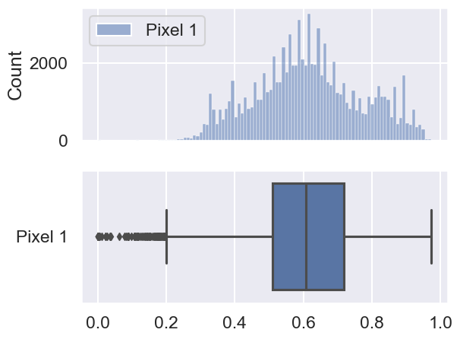
Dataset analysis The PathMNIST dataset (Part of MedMNIST v2)
Obviously, it is not easy to describe the dataset properly when considering only some images
To better describe the dataset, histograms or boxplot make more sense:
Both allow to estimate the distribution

Slide 14
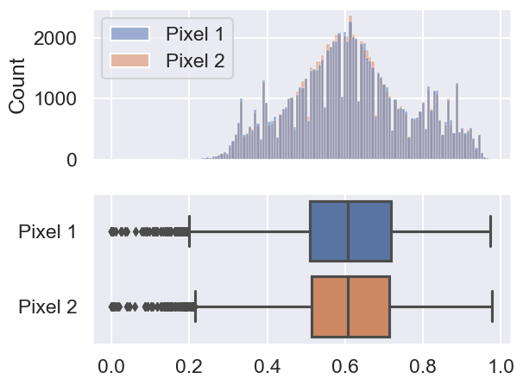
Dataset analysis The PathMNIST dataset (Part of MedMNIST v2)
Obviously, it is not easy to describe the dataset properly when considering only some images
To better describe the dataset, histograms or boxplot make more sense:
Both allow to estimate the distribution
Both allow to overlay several pixels

Slide 15
Dataset analysis The PathMNIST dataset (Part of MedMNIST v2)
Obviously, it is not easy to describe the dataset properly when considering only some images
To better describe the dataset, histograms or boxplot make more sense:
Both allow to estimate the distribution
Both allow to overlay several pixels
What can we observe?
The values are bounded between zero and one
The histogram shows several local maxima

Slide 16
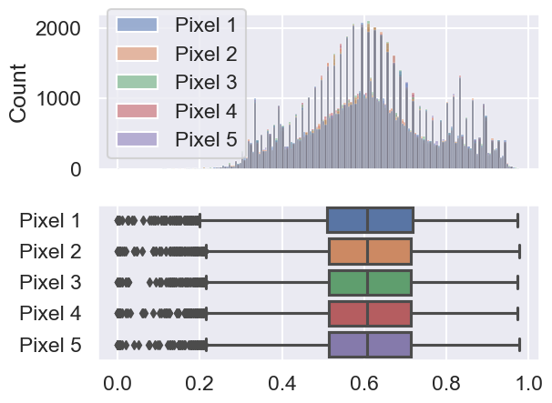
Dataset analysis The PathMNIST dataset (Part of MedMNIST v2)
Obviously, it is not easy to describe the dataset properly when considering only some images
To better describe the dataset, histograms or boxplot make more sense:
Both allow to estimate the distribution
Both allow to overlay several pixels
What can we observe?
The values are bounded between zero and one
The histogram shows several local maxima
The pixels show a similar distribution

Slide 17
Dataset analysis Preprocessing
Preprocessing typically includes several steps, such as scaling and dimensional reduction.
For scaling, there exists a vast of methods, each of which with specific properties:
Normalization (normalize between zero and one)
Standardization (normalize to zero mean and standard deviation of one)
Logarithmic compression
…
Use some time to explore different methods for preprocessing:
Feature scaling methods: https://scikit-learn.org/stable/modules/preprocessing.html
Image transformations: https://pytorch.org/vision/stable/transforms.html

Slide 18
Dataset analysis Preprocessing
Preprocessing typically includes several steps, such as scaling and dimensional reduction.
For scaling, there exists a vast of methods, each of which with specific properties:
Normalization (normalize between zero and one)
Standardization (normalize to zero mean and standard deviation of one)
Logarithmic compression
…
Use some time to explore different methods for preprocessing:
Feature scaling methods: https://scikit-learn.org/stable/modules/preprocessing.html
Image transformations: https://pytorch.org/vision/stable/transforms.html
For the sake of this dataset, we restrict ourselves to center our data around zero.

Slide 19
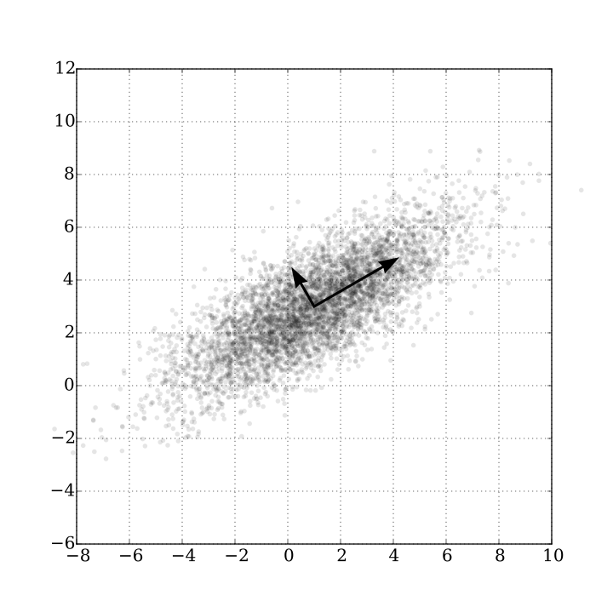
Dataset analysis Preprocessing
Dimensional reduction is useful if some features (e.g. pixels) do not carry information.
Principal Component Analysis (PCA) is very common
Current trend: Bottleneck features of autoencoders
…
PCA rotates the coordinate systems
Most of the variance in the dataset is explained with only a few dimensions
https://upload.wikimedia.org/wikipedia/commons/f/f5/GaussianScatterPCA.svg

Slide 20
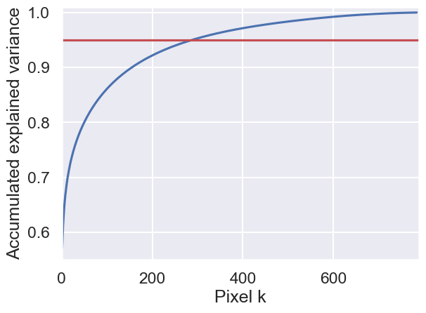
Dataset analysis Preprocessing
Dimensional reduction is useful if some features (e.g. pixels) do not carry information.
Principal Component Analysis (PCA) is very common
Current trend: Bottleneck features of autoencoders
…
PCA rotates the coordinate system
Most of the variance in the dataset is explained with only a few dimensions
Dimensions that explain fewer variance (e.g., less than 95%) can be removed
Ringnér, M. What is principal component analysis?. Nat Biotechnol 26, 303–304 (2008). https://doi.org/10.1038/nbt0308-303

Slide 21
Dataset analysis Preprocessing
Dimensional reduction is useful if some features (e.g. pixels) do not carry information.
Principal Component Analysis (PCA) is very common
Current trend: Bottleneck features of autoencoders
…
PCA rotates the coordinate systems
Most of the variance in the dataset is explained with only a few dimensions
Dimensions that explain fewer variance (e.g., less than 95%) can be removed
Within this workshop, we do not reduce the dimensionality
Ringnér, M. What is principal component analysis?. Nat Biotechnol 26, 303–304 (2008). https://doi.org/10.1038/nbt0308-303

Slide 22
Image classification
From linear classifier to neural networks

Slide 23
Image classification Getting started
Image classification means to assign an image to a class
For classification, there exists a vast variety of methods, we focus on:
Linear classifiiers
Multilayer perceptrons (MLP)
Convolutional Neural Network (CNN)
Neural networks with Long-Short term Memory (LSTM)
These methods differ in their complexity, speed and required input data transformations

Slide 24
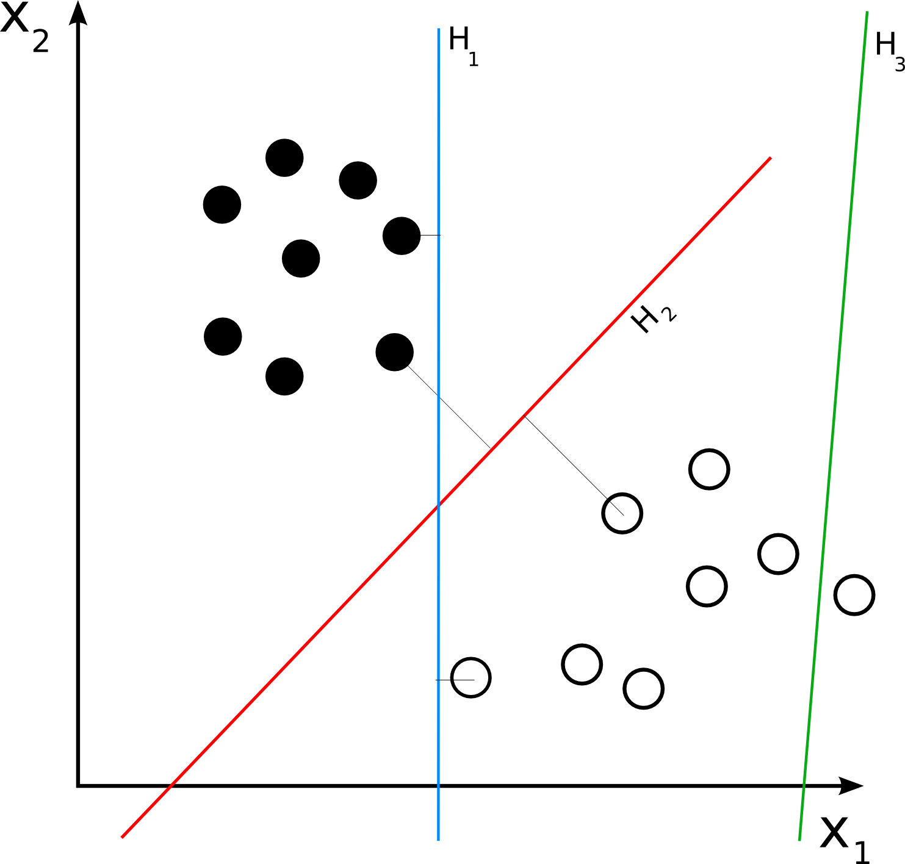
Image classification Linear classification
Linear classification is often a baseline for complex models
The main idea is to separate different classes using straight lines or hyperplanes
Implementation of linear regression in Python:
Linear classifiers directly included in scikit-learn
A bit more effort required in PyTorch
Data preparation is important:
Image data needs to be flattened
28x28 images become 784 dimensional vectors
Demonstration in the Jupyter Notebook
https://upload.wikimedia.org/wikipedia/commons/2/20/Svm_separating_hyperplanes.png

Slide 25
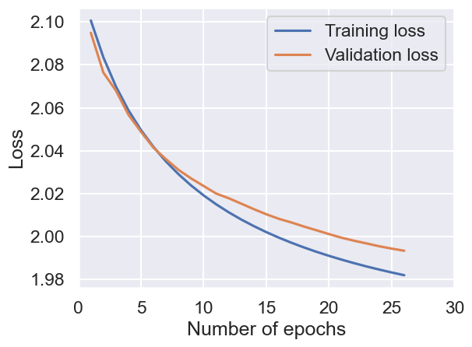
Image classification Linear classification
Linear classifiers directly map the flattened input images to the target outputs.
Both, the scikit-learn and PyTorch model achieve similar results
Scikit-learn accuracy: 44.1%
PyTorch accuracy: 43.6%
PyTorch vs. scikit-learn:
The PyTorch implementation is more difficult and slowlier
It offers more flexibility for optimization
https://scikit-learn.org/stable/modules/generated/sklearn.linear_model.SGDClassifier.html

Slide 26
Image classification Multilayer perceptron (MLP)
The multilayer perceptron (MLP) is a simple feed-forward neural network
The input is connected to several hidden layers
After each weight matrix follows a nonlinear activation function
Comparison with linear regression:
More free parameters to be trained
The classes are non-linearly separated
Data preparation is still important:
Image data needs to be flattened
28x28 images become 784 dimensional vectors
Demonstration in the Jupyter Notebook:

Slide 27
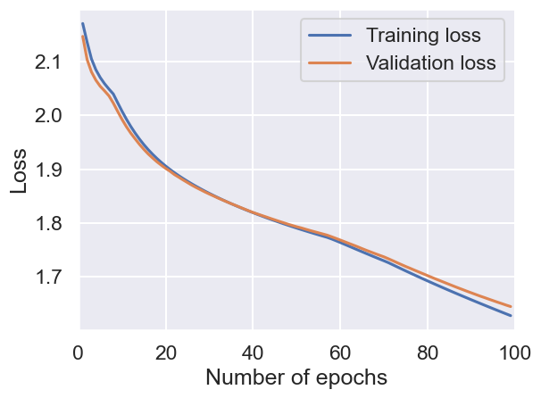
Image classification Multilayer perceptron (MLP)
The multilayer perceptron (MLP) is a simple feed-forward neural network
The input is connected to several hidden layers
After each weight matrix follows a nonlinear activation function
Comparison with linear regression:
More free parameters to be trained
The classes are non-linearly separated
Data preparation is still important:
Image data needs to be flattened
28x28 images become 784 dimensional vectors
Demonstration in the Jupyter Notebook:
Accuracy 52.1% (vs. 43.6% of the linear model)

Slide 28
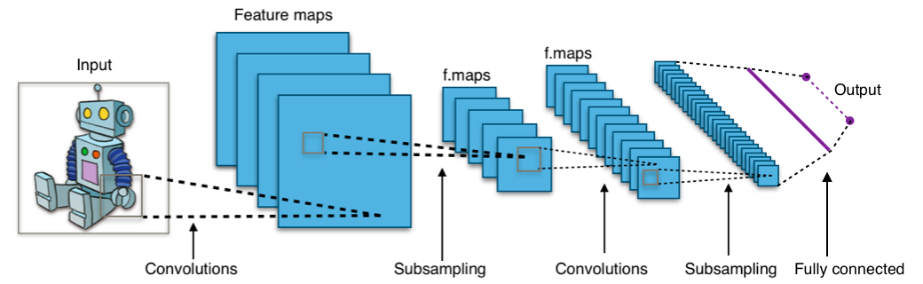
Image classification Convolutional Neural Network (CNN)
The Convolutional Neural Network (CNN) is a special kind of feed-forward neural network
Building blocks:
Convolutional layers: convolve the input to feature maps
Pooling layers: reduce the dimensionality by combining neighboured elements of the feature maps
Fully connected layer: Traditional MLP that connects the final feature maps to the (classification) outputs
https://commons.wikimedia.org/wiki/File:Typical_cnn.png

Slide 29
Image classification Convolutional Neural Network (CNN)
The Convolutional Neural Network (CNN) is a special kind of feed-forward neural network
Building blocks:
Convolutional layers: convolve the input to feature maps
Pooling layers: reduce the dimensionality by combining neighboured elements of the feature maps
Fully connected layer: Traditional MLP that connects the final feature maps to the (classification) outputs
Advantages:
The size of the kernels are invariant to the image size – allows for deeper architectures
The feature maps reduce the amount of redundant information in the image
Less preprocessing required – image does not need to be flattened anymore
Demonstration in the Jupyter Notebook:
Gu, Jiuxiang, et al. "Recent advances in convolutional neural networks." Pattern recognition 77 (2018): 354-377.

Slide 30
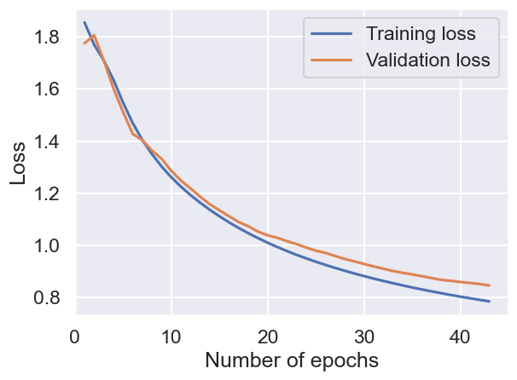
Image classification Convolutional Neural Network (CNN)
The Convolutional Neural Network (CNN) is a special kind of feed-forward neural network
Building blocks:
Convolutional layers: convolve the input to feature maps
Pooling layers: reduce the dimensionality by combining neighboured elements of the feature maps
Fully connected layer: Traditional MLP that connects the final feature maps to the (classification) outputs
Advantages:
The size of the kernels are invariant to the image size – allows for deeper architectures
The feature maps reduce the amount of redundant information in the image
Less preprocessing required – image does not need to be flattened anymore
Demonstration in the Jupyter Notebook:
Accuracy 76.9% (vs. 52.1% of the MLP model)

Slide 31
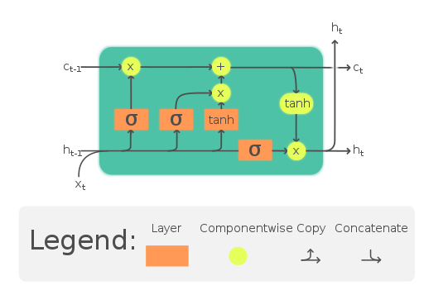
Image classification Neural Network with Long Short-term Memory (LSTM)
The Long Short-Term Memory (LSTM) network is a complex Recurrent Neural Network (RNN)
Building blocks:
Cell: Remembers values over a time
Input gate: decides which new information is stored in the current state
Output gate: controls which part of the current state is output
Forget gate: decides what information to discard from a previous state
Advantages:
Can deal with sequential data
Can store data for a long time
Demonstration in the Jupyter Notebook:
Hochreiter, Sepp, and Jürgen Schmidhuber. "Long short-term memory." Neural computation 9.8 (1997): 1735-1780.
https://upload.wikimedia.org/wikipedia/commons/9/93/LSTM_Cell.svg

Slide 32
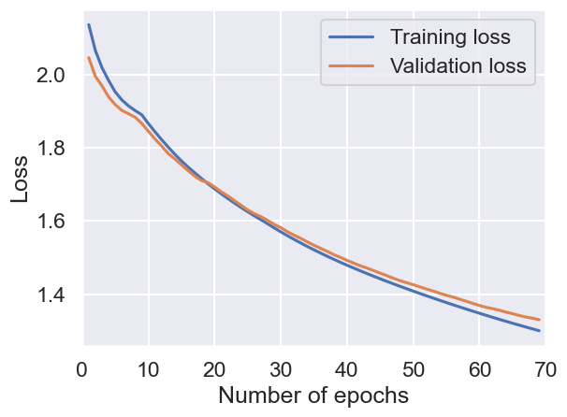
Image classification Neural Network with Long Short-term Memory (LSTM)
The Long Short-Term Memory (LSTM) network is a complex Recurrent Neural Network (RNN)
Building blocks:
Cell: Remembers values over a time
Input gate: decides which new information is stored in the current state
Output gate: controls which part of the current state is output
Forget gate: decides what information to discard from a previous state
Advantages:
Can deal with sequential data
Can store data for a long time
Demonstration in the Jupyter Notebook:
Accuracy 59.8% (vs. 52.1% of the MLP model)

Slide 33
Conclusions
Machine learning is an important topic with potential applications in many research areas
This workshop illustrated several aspects of getting started with an ML task:
Data analysis is a crucial step that is often underestimated (even by advanced researchers)
Proper preprocessing steps prepare the data such that subsequent tasks can be solved easier
The investigated models have different properties making them more or less suitable to solve a task
The ML frameworks simplify researchers without many programming skills to get started:
Good documentation is available online
The focus should lie more on optimizing models for a given task

Slide 34
Thank you all for your attention!
I am open for further discussions

Slide 35
References
J. Dean, D. Patterson and C. Young, "A New Golden Age in Computer Architecture: Empowering the Machine-Learning Revolution," in IEEE Micro, vol. 38, no. 2, pp. 21-29, Mar./Apr. 2018, doi: 10.1109/MM.2018.112130030.
Yang, J., Shi, R., Wei, D. et al. MedMNIST v2 - A large-scale lightweight benchmark for 2D and 3D biomedical image classification. Sci Data 10, 41 (2023). https://doi.org/10.1038/s41597-022-01721-8
Ringnér, M. What is principal component analysis?. Nat Biotechnol 26, 303–304 (2008). https://doi.org/10.1038/nbt0308-303
Paszke, Adam, et al. "Pytorch: An imperative style, high-performance deep learning library." Advances in neural information processing systems 32 (2019).
Pedregosa, Fabian, et al. "Scikit-learn: Machine learning in Python." the Journal of machine Learning research 12 (2011): 2825-2830.
Abadi, Martín, et al. "{TensorFlow}: a system for {Large-Scale} machine learning." 12th USENIX symposium on operating systems design and implementation (OSDI 16). 2016.
Gu, Jiuxiang, et al. "Recent advances in convolutional neural networks." Pattern recognition 77 (2018): 354-377.
Hochreiter, Sepp, and Jürgen Schmidhuber. "Long short-term memory." Neural computation 9.8 (1997): 1735-1780.
Graves, Alex, and Alex Graves. "Long short-term memory." Supervised sequence labelling with recurrent neural networks (2012): 37-45.

